Slide 1
99 Technical Data Package
D. Croft

Slide 2
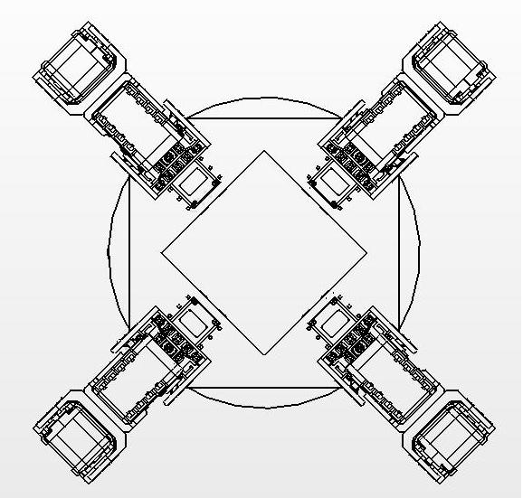
Body Naming Conventions
Leg 2
Leg 1
θ_{2,0}
y
θ_{1,0}
Angle Naming Convention
θ_{pitch}= θ_{y}
θ_{Leg#, Joint#}
x
θ_{yaw}= θ_{z}
z
θ_{roll}= θ_{x}
θ_{3,0}
R_{sh}
Leg 4
Leg 3
θ_{4,0}
R_{ft}

Slide 3
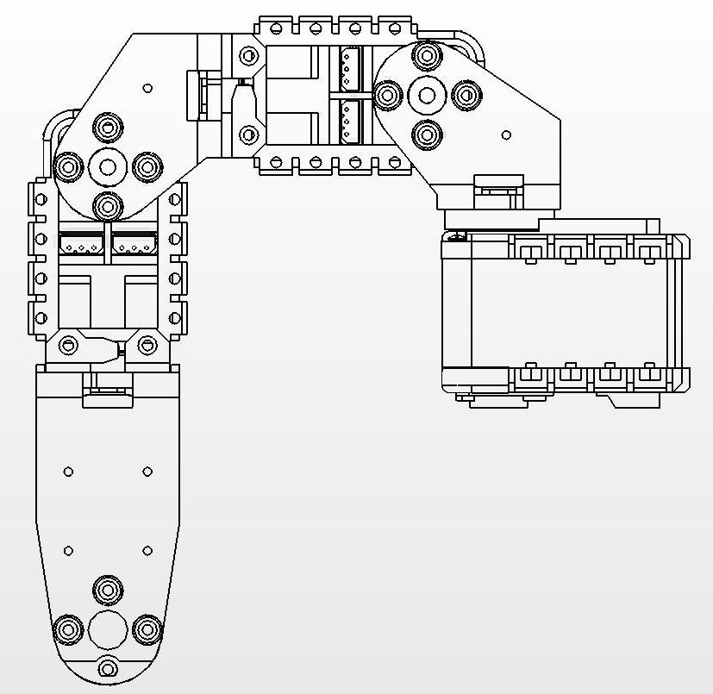
Leg Naming Conventions
Point Naming Convention
θ_{L,1}
x_{Leg#, Point#}
(x_{L,φ}, y_{L,φ}, z_{L,φ})
(x_{L,1}, y_{L,1}, z_{L,1})
L_{o}
L₁
φ
(x_{L,0}, y_{L,0}, z_{L,0})
Angle Naming Convention
θ_{L,2}
θ_{Leg#, Joint#}
θ_{L,0}
L₂
(x_{L,2}, y_{L,2}, z_{L,2})

Slide 4
Leg Naming Conventions
Point Naming Convention
θ_{L,1}
x_{Leg#, Point#}
(x_{L,φ}, y_{L,φ}, z_{L,φ})
L_{o}
(x_{L,1}, y_{L,1}, z_{L,1})
P_{φ}
θ_{L,2}
L₁
φ
(x_{L,0}, y_{L,0}, z_{L,0})
P₁
Angle Naming Convention
P₀
θ_{Leg#, Joint#}
θ_{L,0}
L₂
(x_{L,2}, y_{L,2}, z_{L,2})
P₂

Slide 5
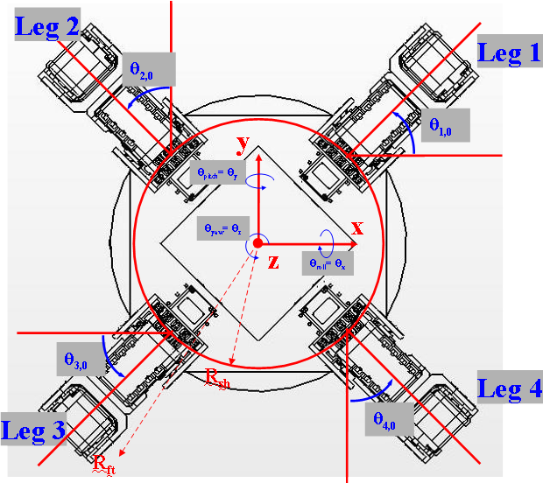
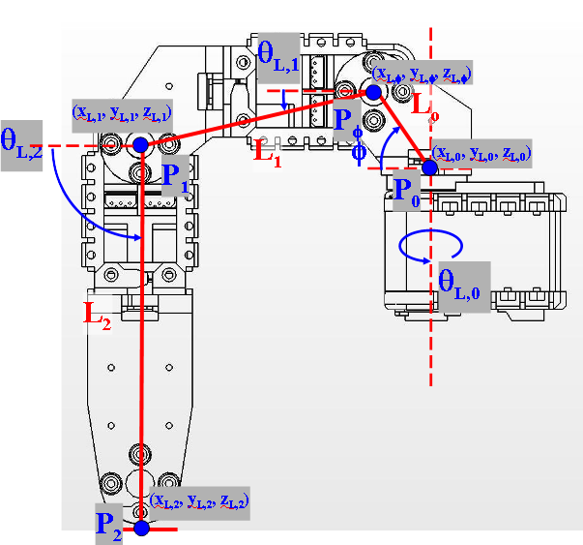
Joint 1 Kinematics
$\begin{aligned}x_{1}=x_{ϕ}+L_{1}cos\left(θ_{1}\right)cos\left(θ_{0}\right) \\ y_{1}=y_{ϕ}+L_{1}cos\left(θ_{1}\right)sin\left(θ_{0}\right) \\ z_{1}=z_{ϕ}−L_{1}sin\left(θ_{1}\right)\end{aligned}$
Joint φ Kinematics
Joint 2 Kinematics
$\begin{aligned}x_{ϕ}=x_{0}+L_{0}cos\left(ϕ\right)cos\left(θ_{0}\right) \\ y_{ϕ}=y_{0}+L_{0}cos\left(ϕ\right)sin\left(θ_{0}\right) \\ z_{ϕ}=z_{0}+L_{0}sin\left(ϕ\right)\end{aligned}$
$\begin{aligned}x_{2}=x_{1}+L_{2}cos\left(θ_{2}\right)cos\left(θ_{0}\right) \\ y_{2}=y_{1}+L_{2}cos\left(θ_{2}\right)sin\left(θ_{0}\right) \\ z_{2}=z_{1}−L_{2}sin\left(θ_{2}\right)\end{aligned}$

Slide 6
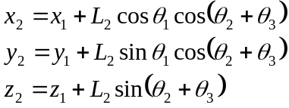
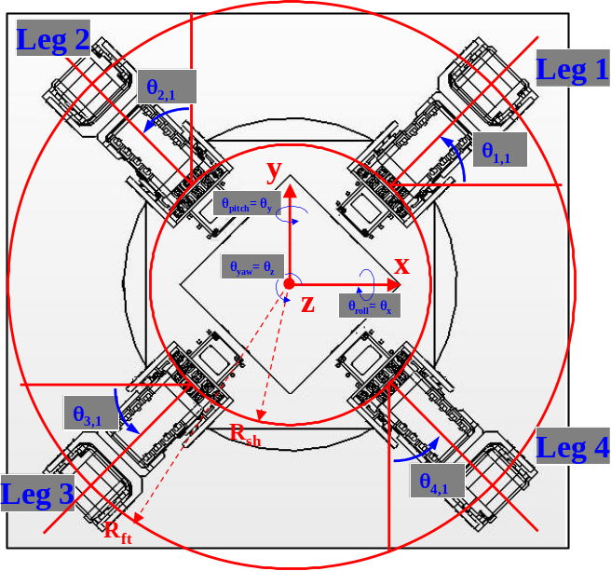
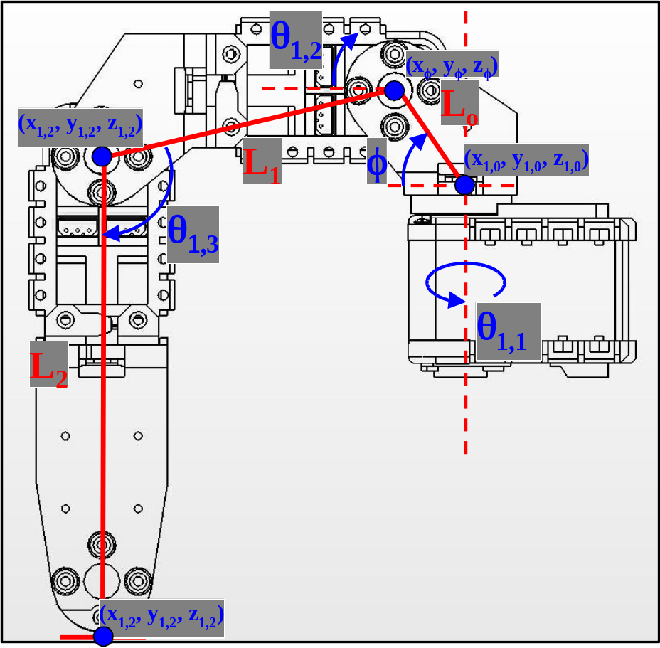
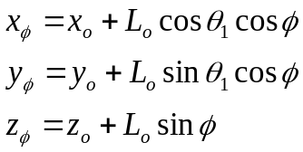
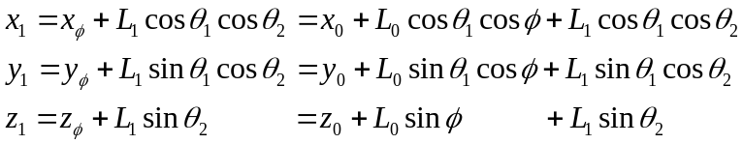
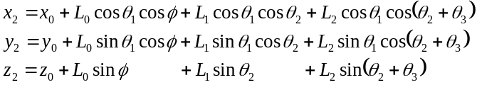
Forward Kinematics
Joint 2 Kinematics
Joint 1 Kinematics
Total Forward Kinematics
Joint 3 Kinematics

Slide 7
Settings
// Body Dimensions Front Legs
#define L0F 1.07044 // Shoulder Fixed Length (in)
#define L1F 2.60275 // Upper Leg (Femur) Length (in)
#define L2F (3.89030) // Lower Leg (Tibia) Length (in)
#define PhiF 1.00830 // Shoulder Fixed Angle (rad)
#define RSHF 4.12500 // Shoulder Joint Radius (in)
#define HSHF (3.59245-.1) // Shoulder Joint Height (in)
#define LFTF (3.11024+.3) // Foot Radius - Joint Radius (in)
// Body Dimensions Rear Legs
#define L0R 1.07044 // Shoulder Fixed Length (in)
#define L1R 2.60275 // Upper Leg (Femur) Length (in)
#define L2R 3.89030 // Lower Leg (Tibia) Length (in)
#define PhiR 1.00830 // Shoulder Fixed Angle (rad)
#define RSHR 4.12500 // Shoulder Joint Radius (in)
#define HSHR (3.59245-.1) // Shoulder Joint Height (in)
#define LFTR (3.11024+.3) // Foot Radius - Joint Radius (in)
// Offsets used in calculation of Dynamixel angle commands
#define offsetT11 -45.0000 // Theta1 Offset - Leg1 (deg)
#define offsetT21 -135.0000 // Theta1 Offset - Leg2 (deg)
#define offsetT31 135.0000 // Theta1 Offset - Leg3 (deg)
#define offsetT41 45.0000 // Theta1 Offset - Leg4 (deg)
#define offsetT2 12.6699 // Theta2 Offest - All Legs (deg)
#define offsetT3 77.3302 // Theta3 Offset - All Legs (deg)

Slide 8
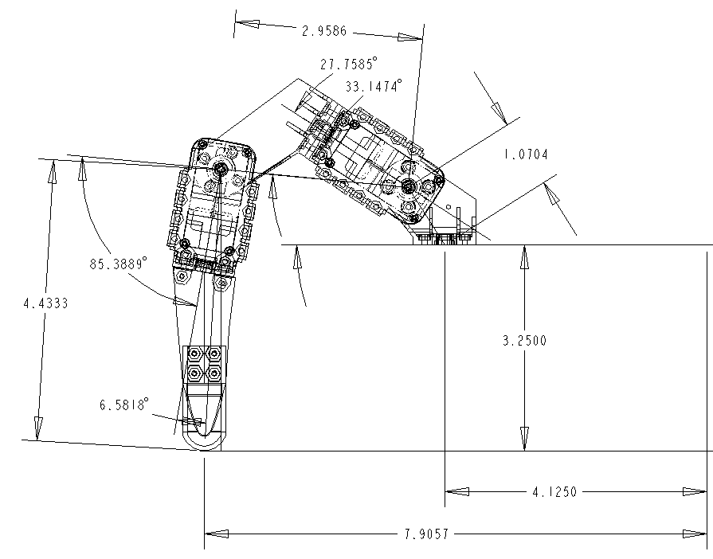
Rear Legs
// Body Dimensions Rear Legs
#define L0R 1.07044 // Shoulder Fixed Length (in)
#define L1R 2.9586 // Upper Leg (Femur) Length (in)
#define L2R 4.4333 // Lower Leg (Tibia) Length (in)
#define PhiR 1.00830 // Shoulder Fixed Angle (rad)
#define RSHR 4.12500 // Shoulder Joint Radius (in)
#define HSHR (3.2500) // Shoulder Joint Height (in)
#define LFTR (3.7807) // Foot Radius - Joint Radius (in)
#define offsetT2 27.7585 // Theta2 Offest - All Legs (deg)
#define offsetT3 85.3889 // Theta3 Offset - All Legs (deg)
L₁
L_{o}
(x_{1,2}, y_{1,2}, z_{1,2})
φ
Offset = -27.7585°
Offset = -85.3889°
(x_{1,0}, y_{1,0}, z_{1,0})
Dynamixel 512 (150°)
L₂
θ_{1,1}
Offset = -6.5818°
(x_{1,2}, y_{1,2}, z_{1,2})

Slide 9
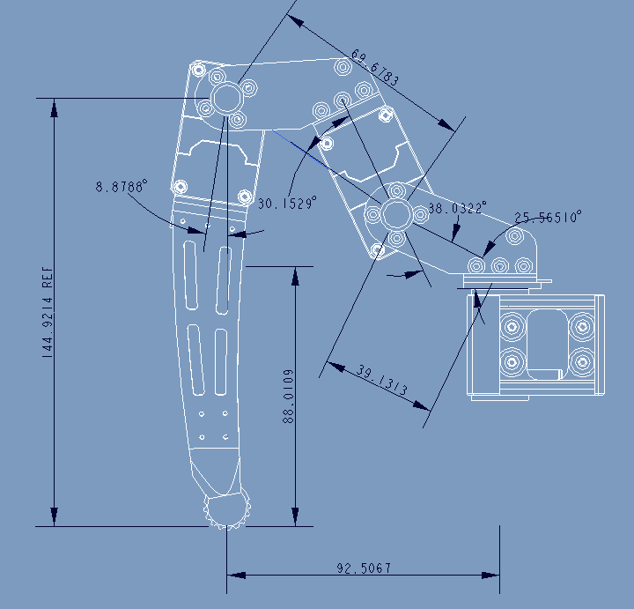
Leg Dimensions
L₁
2.7432 in
Offset = 115.5990°
2.0176 rad
0.6638 rad
Offset = 38.0322°
Offset = 8.8788°
φ=25.56510º
0.1550 rad
0.4462 rad
L₂
L_{o}
5.7056 in
1.5406 in
H_{Sh}
3.4650 in
L_{Ft}
3.6420 in

Slide 10
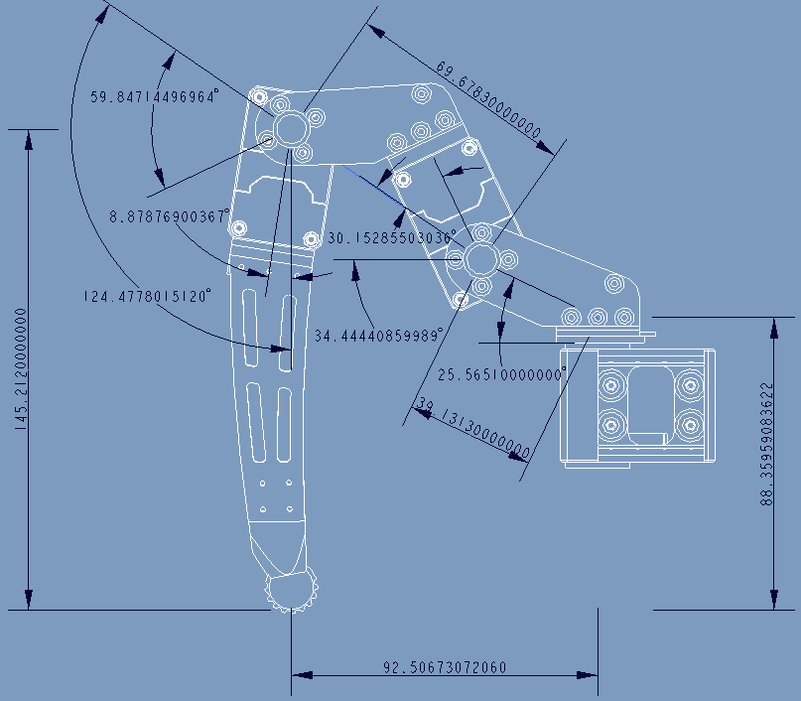
Leg Nominal Dimensions
L₁
2.7432401574803 in
Offset -59.84714496964 rad
Dynamixel Zero
Offset = -30.15285503036°
θ₂ = 125.0°
Dynamixel Zero
φ=25.56510º
0.446195168601602 rad
θ₁ = -35.0°
L₂
5.71700787401575 in
Curve Offset
-8.87876900367
H_{Sh}
3.47872914555613 in
L_{o}
1.54059055118110 in
L_{Ft}
3.64199728346457 in

